Slide 1






A General suspiciousness metric for dense blocks in multimodal data
Meng Jiang, University of Illinois at Urbana-Champaign, USA
Joint work with
Alex Beutel (CMU), Peng Cui (Tsinghua), Bryan Hooi (CMU),
Shiqiang Yang (Tsinghua), Christos Faloutsos (CMU)

Slide 2
Introducing Myself: Meng Jiang
2012-2013

Slide 3
Introducing Myself: Meng Jiang
KDD 2014
Best paper finalist

Slide 4
Introducing Myself: Meng Jiang
ICDM paper
May, 2015

Slide 5
Introducing Myself: Meng Jiang
Ph.D.,Tsinghua
June, 2015

Slide 6
Introducing Myself: Meng Jiang
Postdoc, UIUC
August, 2015

Slide 7
Suppose You Work in Twitter
My boss wants me to
catch fraud in such a big table – billions of records, tens of columns!!! How?!
fraud

Slide 8

Suspicious Behaviors in Multi-Modal Data

Slide 9
Massive Multi-Modal Data: Lines & Columns (Modes)
Dataset | Mode |  |  |  | Mass
Retweeting | User | Root ID | IP | Time (min) | #retweet
 | 29.5M | 19.8M | 27.8M | 56.9K | 211.7M
Trending (Hashtag) | User | Hashtag | IP | Time (min) | #tweet
 | 81.2M | 1.6M | 47.7M | 56.9K | 276.9M
Network attacks (LBNL) | Src-IP | Dest-IP | Port | Time (sec) | #packet
 | 2,345 | 2,355 | 6,055 | 3,610 | 230,836

Slide 10


Dense Blocks Indicates Suspiciousness
200 minutes
time
225
user
27,313

Slide 11
Dense Blocks Indicates Suspiciousness
120 minutes
time
user
40
IP
12,375
2

Slide 12
Dense Blocks Indicates Suspiciousness
120 minutes
time
+Hashtag
+Item
+Product
+Location
+…
user
40
IP
12,375
2

Slide 13
Dense Blocks Indicates Suspiciousness
200 minutes
120 minutes
time
time
user
225
user
40
IP
12,375
2
27,313
Question: Which is more suspicious?
- Before we search, we should be able to rank.

Slide 14
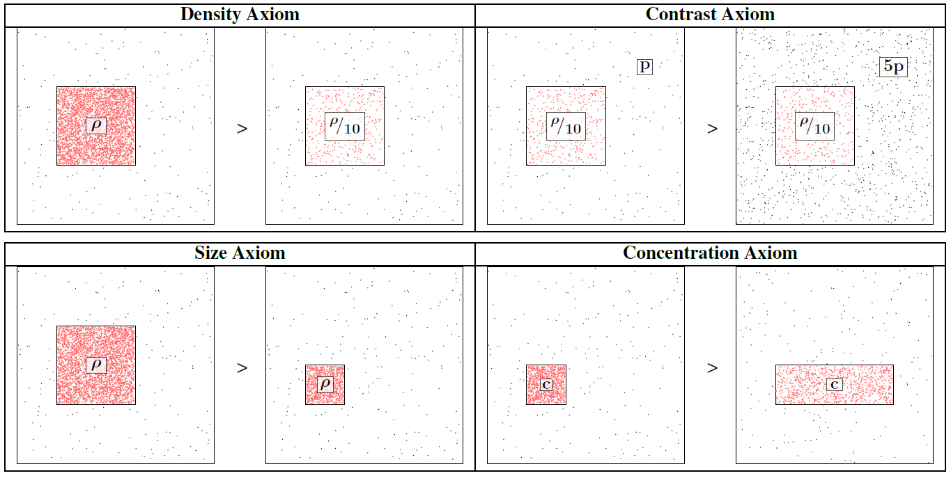
Axioms

Slide 15
A General Idea to Quantify Suspiciousness
200 minutes
120 minutes
time
time
user
225
user
40
IP
12,375
2
27,313
Probability
0.9%
0.05%

Slide 16
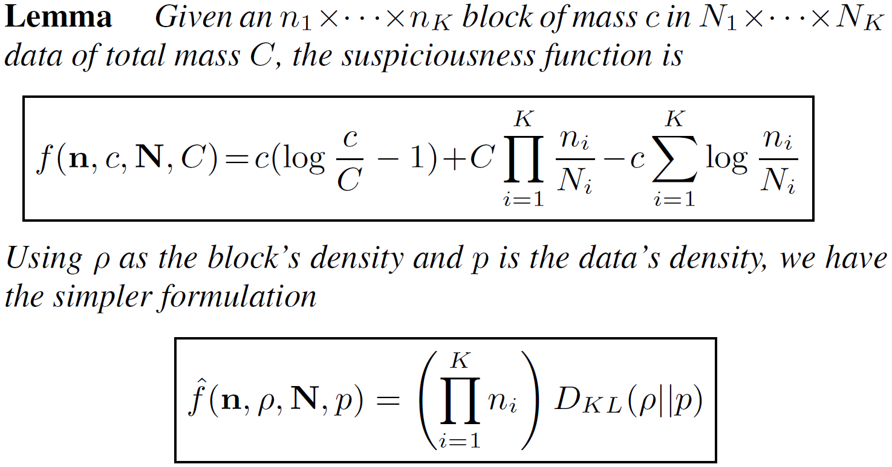
A General Suspiciousness Metric
Negative log likelihood of block’s probability
CrossSpot: Local search

Slide 17
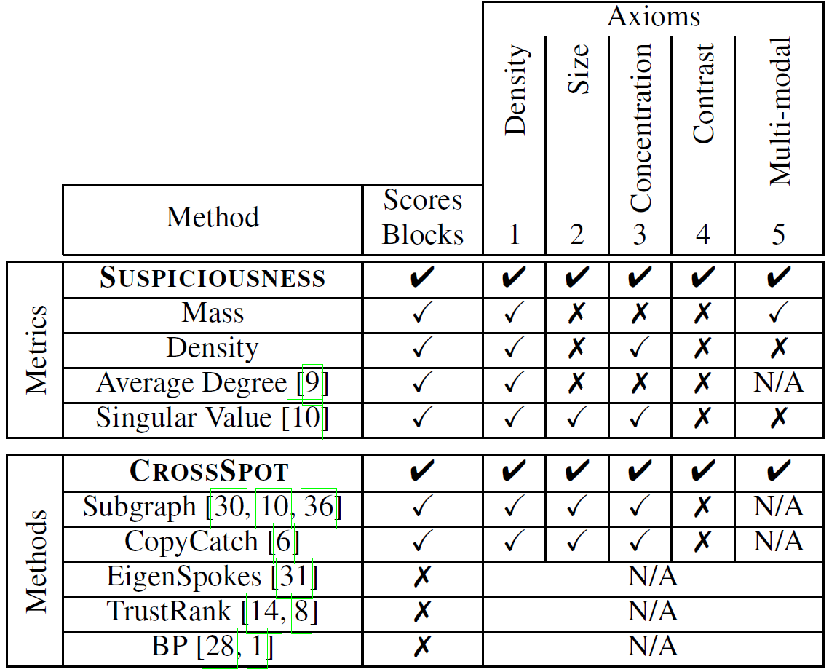
Advantage: “Suspiciousness”+CrossSpot
Scoring dense blocks
Targeting multi-modal data
Satisfying axioms

Slide 18
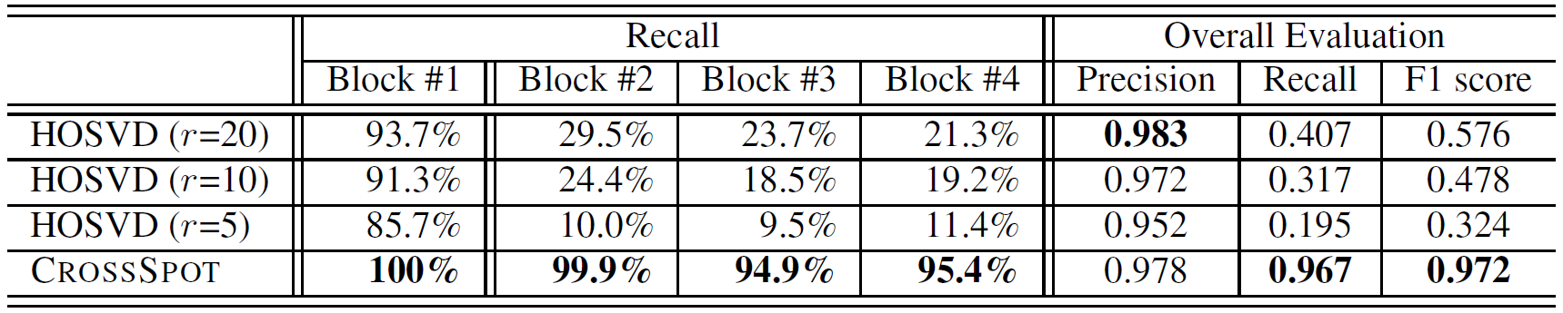
Performance: Synthetic Data
Experiments: Synthetic data
1,000×1,000×1,000 of 10,000 random data
Block#1: 30×30×30 of 512 3 modes
Block#2: 30×30×1,000 of 512 2 modes
Block#3: 30×1,000×30 of 512 2 modes
Block#4: 1,000×30×30 of 512 2 modes

Slide 19
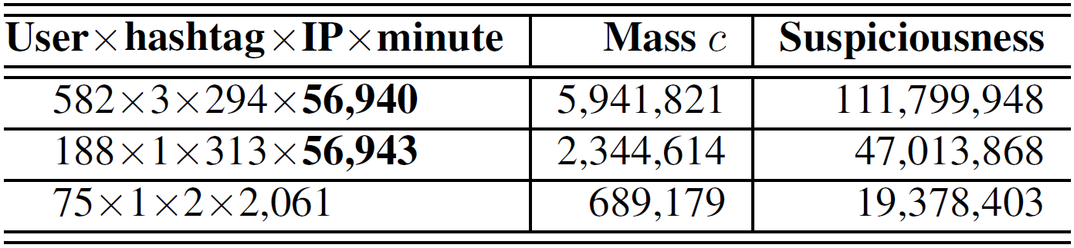
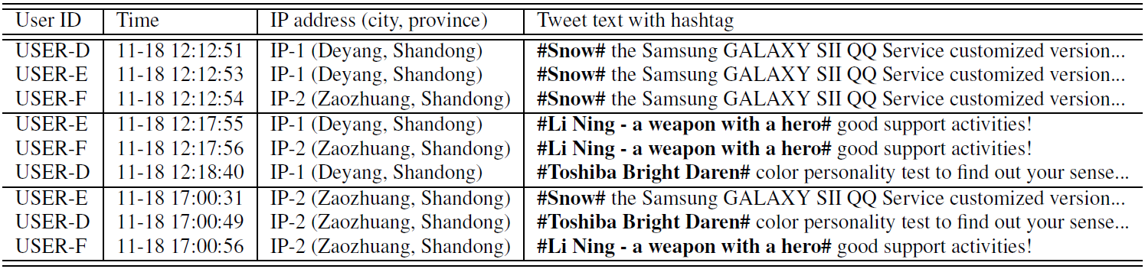
Performance: Manipulating Trends

Slide 20
Conclusion
Proposed a general “suspiciousness” metric based on probability for multi-modal behaviors
CrossSpot: Proposed a local search algorithm for catching suspicious behaviors
Thank you!
Meng Jiang, UIUC
mjiang89@gmail.com
www.meng-jiang.com

